Slide 1
Fundamentals of Machine Learning
Prepared by
Dr Prince Thomas

Slide 2
Chapter 2: Supervised Machine Learning: Linear Models and Fundamentals
Linear Regression
- Simple Linear Regression and Multiple Linear Regression
- Cost Function (Mean Squared Error)
- Gradient Descent for Linear Regression
Logistic Regression (Linear Classification)
- Sigmoid Function and Decision Boundaries
- Binary Classification vs. Multi-class Classification
Gradient Descent Algorithm
- Stochastic Gradient Descent (SGD) vs. BGD
- Learning Rate and Convergence Issues
Overfitting and Underfitting
- Bias-Variance Trade-off
- Cross-Validation Techniques
Regularization Techniques (L1, L2)
- Lasso and Ridge Regression
- High Dimensional Data
- Curse of Dimensionality and Feature Selection
Multivariate Methods
- Covariance Matrix
- Linear Models for Multivariate Regression
Parametric vs. Non-parametric Methods
- Differences, Examples, and Use Cases

Slide 3
Supervised Learning:
Models learn from labeled datasets, where each data point contains both features (input) and corresponding labels (correct output).
The objective is to predict the label for new, unseen data points using the patterns learned from the training data.
Example Applications:
Predicting house prices based on features like area, number of rooms, etc.
Identifying spam emails based on words in the email.

Slide 4
What are Linear Models:
Linear models are the simplest and most widely used models in supervised learning.
Relationship between the input (independent variable) and the output (dependent variable) by fitting a straight line or plane.
Types
Linear Regression
Logistic Regression
Ridge Regression
Lasso Regression
Elastic Net
Support Vector Machine (SVM) with Linear Kernel
Generalized Linear Models (GLM)
Multinomial Logistic Regression
Quantile Regression

Slide 5
Introduction to Linear Regression
Linear Regression is a fundamental statistical method used in machine learning and data analysis to model the relationship between a dependent variable and one or more independent variables.
It assumes a linear relationship, which means the change in the dependent variable can be explained by a linear combination of the independent variables.
Types:
Simple Linear Regression
Multiple Linear Regression

Slide 6
Here X is input and Y is output.
plotted these points in graph and drawing the best fit line using the data points.
using the best fit line can find the prediction for new input value.

Slide 7
Simple Linear Regression
Definition: Simple Linear Regression involves one independent variable (feature) and one dependent variable (target).
Assumptions:
Linearity: The relationship between variables is linear.
Independence: Observations are independent of each other.
Homoscedasticity: Constant variance of errors.
Normality: Errors are normally distributed.

Slide 8
Multiple Linear Regression
Definition: Multiple Linear Regression extends Simple Linear Regression by using two or more independent variables to predict the dependent variable.

Slide 9
Year of Experience is input and Predicting salary is output
Here two independant values are biking to work and smoking. dependant value is prediction heart disease

Slide 10
Cost Function
Definition: The cost function measures how well the linear regression model fits the data. It quantifies the error between predicted values and actual values.

Slide 11
Gradient Descent: Gradient Descent is an optimization algorithm used to minimize the cost function by iteratively adjusting the model parameters.
learning rate (α) is a hyperparameter that determines the size of the steps taken towards the minimum of the cost function during the optimization process.
If the learning rate is set too high, the algorithm may take large steps and overshoot the minimum
If the learning rate is set too low, the algorithm will take very small steps. meaning it will take a long time to reach the minimum of the cost function

Slide 12
How Simple Linear Regression Works
1. Initialization:
We start with random values for the intercept (Bo) and slope (B1). These values are our initial guesses for the best-fit line.
2. Cost Function Calculation:
For each data point, calculate the predicted value y_hat using the current values of Bo and B1.
Calculate the squared difference between the actual value y and the predicted value y_hat.
Finally, average these squared differences to get the Mean Squared Error (MSE), which is our cost function.

Slide 13
3. Gradient Calculation:
Calculate the partial derivatives of the MSE with respect to Bo and B1. These derivatives tell us how much the MSE changes when we slightly adjust Bo and B1.
4. Parameter Update:
Update Bo and B1 by subtracting a small step in the direction opposite to the gradient. The size of this step is determined by the learning rate.
A high learning rate means, it take larger steps, which can lead to faster convergence but also increase the risk of overshooting the minimum.
A low learning rate means, it take smaller steps, which can lead to slower convergence but a more stable optimization process.
5. Iteration:
Repeat steps 2-4 until the changes in the MSE become negligible, indicating that we have reached a minimum.

Slide 14
Applications of simple linear regression:
Predictive Modeling
Sales Forecasting
Real Estate Pricing
Trend Analysis
Economic Indicators
Market Research
Quality Control
Manufacturing Output Monitoring
Social Sciences
Education (Study Hours vs. Performance)
Health Studies (Lifestyle Factors vs. Health Outcomes)
Finance
Risk Assessment (Market Factors vs. Stock Prices)
Environmental Studies
Climate Data Analysis (CO2 Emissions vs. Temperature)
Sports Analytics
Performance Analysis (Training vs. Performance Metrics)

Slide 15
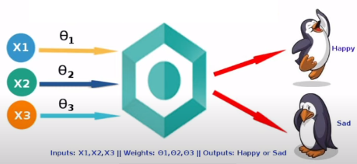
Logistic Regression (Linear Classification)
Logistic Regression is a supervised learning used for binary classification problems.
logistic regression gives the solution in classification manner using the input values with weight. Logistic regression predicts the probability that a given input belongs to a particular class, instead of giving the exact value as 0 and 1, it gives the probabilistic values which lie between 0 and 1.
Unlike linear regression, it predicts continuous values.

Slide 16
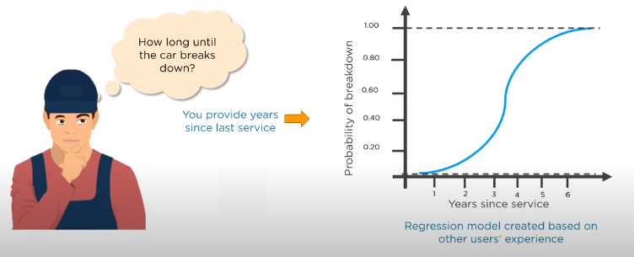

Slide 17
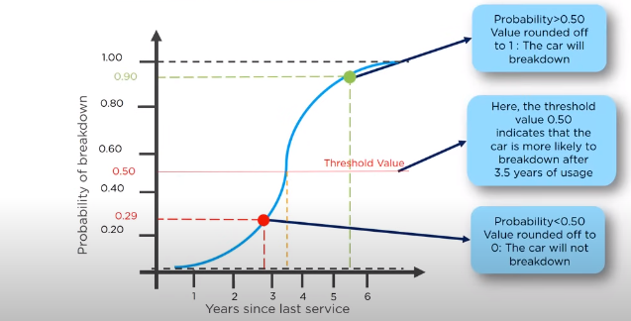

Slide 18
Logistic Function – Sigmoid Function
In simple linear regression best fit line is used to predict and here S shaped logistic function used to predict
The sigmoid function is a mathematical function used to map the predicted values to probabilities. It maps any real value into another value within a range of 0 and 1.
In logistic regression, used the concept of the threshold value, which defines the probability of either 0 or 1. Such as values above the threshold value tends to 1, and a value below the threshold values tends to 0

Slide 19
Decision Boundaries
Definition: The decision boundary is the threshold that separates different classes in the feature space.
For Logistic Regression:
The decision boundary is defined where the predicted probability is 0.5: This implies that the linear combination of features results in a score of 0.

Slide 20
Binary Classification
Overview: Logistic regression is primarily used for binary classification problems where there are two classes (e.g., 0 and 1). Example: Predicting if an email is spam (1) or not spam (0).
Multi-class Classification
Overview: While logistic regression is inherently binary, it can be extended to multi-class classification using strategies like One-vs-Rest (OvR) or Softmax regression.
One-vs-Rest (OvR): For K classes, K separate binary classifiers are trained. Each classifier predicts whether the input belongs to a particular class or not.
Softmax Regression: Softmax generalizes logistic regression to multiple classes. The probability of class k is given by:
where zk is the linear combination of features for class k.

Slide 21
Comparison: Binary vs. Multi-class Classification

Slide 22
Gradient Descent Algorithm: Gradient descent is an optimization algorithm used to minimize a cost function. It iteratively updates the model's parameters (weights) in the direction that reduces the cost. Iteratively moving towards the steepest descent, which is determined by the gradient.
How does it works for Multiple Linear Regression

Slide 24
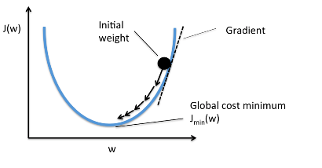
Fixing Direction based on Gradient
Diagram illustrate Gradient Descent, a optimization algorithm used in machine learning to minimize the cost function J(w), where w represents the model's parameters (weights).
The black dot on the right side of the graph represents the initial weight. When we start training the model, the weights are initialized randomly (or based on some heuristic), and this initial weight is often far from the global minimum.

Slide 25
The gradient is the slope of the cost function at the current point. The dashed line shows the slope at the position of the initial weight.
Gradient descent calculates the gradient (or derivative) of the cost function with respect to the weight w.
If the gradient ∇J(w) is positive at the current weight, this means the cost function is increasing as the weight increases. In this case, need to decrease the weight to move toward the minimum.
If the gradient ∇J(w) is negative, the cost function is decreasing as the weight increases. Here, need to increase the weight to move toward the minimum.

Slide 27
Stochastic Gradient Descent (SGD)
Computation: Computes the gradient using a single randomly selected training example.
Efficiency: Efficient for large datasets due to less computation.
Convergence: Can be noisy and slower due to high variance in gradient estimates.
Use Cases: Well-suited for large datasets and online learning.
Batch Gradient Descent (BGD)
Computation: Computes the gradient using the entire dataset.
Stability: More stable updates and smoother convergence.
Efficiency: Can be computationally expensive for large datasets.
Use Cases: Suitable for smaller datasets or well-behaved objective functions.

Slide 28
Learning Rate and Convergence Issues
Learning Rate (α)
The learning rate is a key hyperparameter in gradient descent
It controls how much to change the model's weights in response to the estimated gradient during training. It defines the step size that the algorithm takes while moving towards the minimum of the cost function.
Definition: Learning rate (α) is a scalar value that determines the size of the steps taken during each iteration of gradient descent.
Update Formula: In the weight update rule:
Wnew = Wold − α⋅∇J(w)
α dictates how much to adjust the weights, w in the direction of the negative gradient ∇J(w).

Slide 29
Choosing Learning Rate: Selecting learning rate is crucial because it significantly impacts the training process:
Too High Learning Rate:
When it is too high, the algorithm might take large steps and overshoot the minimum. This can lead to divergence, where the cost function increases instead of decreasing.
Large steps can cause the algorithm to oscillate around the minimum and fail to converge, as it constantly "jumps" over the optimal solution.
Example: Imagine descending a hill in leaps, where each leap overshoots the bottom of the hill, taking you to the opposite side.
Too Low Learning Rate:
A very small learning rate results in small steps, causing the algorithm to take a long time to converge. It may eventually reach the minimum, but the process will be slow and inefficient.
Sometimes, a very low learning rate might cause the algorithm to get stuck in local minima

Slide 30
Optimal Learning Rate:
The ideal learning rate leads to fast and stable convergence. It allows the model to reach the global minimum efficiently without overshooting or slowing down.
To address the challenge of selecting the right learning rate, several strategies are used:
Learning Rate Decay: Gradually reduces the learning rate over time during training to allow for faster convergence initially and more precise steps later.
Adaptive Learning Rates: Algorithms like AdaGrad, RMSprop, and Adam automatically adjust the learning rate for each parameter, making the training more robust and efficient.

Slide 31
Convergence Issues
Convergence refers to the process of reaching the minimum of the cost function (or close to it) where further updates no longer significantly reduce the cost.
Challenges in Convergence:
Divergence: Occurs when the learning rate is too high, causing the model's cost function to increase instead of decreasing. The algorithm "jumps" over the minimum and fails to settle at the optimum.
Slow Convergence: When the learning rate is too low, convergence becomes very slow. The model takes tiny steps and requires a large number of iterations to reach the minimum.
Local Minima: In non-convex cost functions, gradient descent can sometimes get stuck in a local minimum, which is not the global minimum. This is more of a concern in more complex models (e.g., deep learning). Gradient descent is designed to converge to a minimum, but there is no guarantee that it will always find the global minimum.

Slide 32
Saddle Points: Saddle points are points where the gradient is zero but the point is neither a minimum nor a maximum. In complex cost functions, especially in deep learning, saddle points can cause the gradient to become very small, leading to slow or stagnant updates.
Plateaus: Plateaus are flat regions in the cost function where the gradient is nearly zero. When the algorithm hits these regions, it makes minimal progress and appears to stall, causing slow convergence.
Adaptive Learning Rate Methods: Algorithms like Adam, RMSprop, and AdaGrad dynamically adjust learning rates for each parameter, improving convergence and handling slow or divergent learning. Adam combines momentum and adaptive learning.

